Slide 1
NE and Cumbria Early Permanence Project
Legal framework
Alexandra Conroy Harris
Legal Consultant, CoramBAAF
21 October 2024

Slide 2
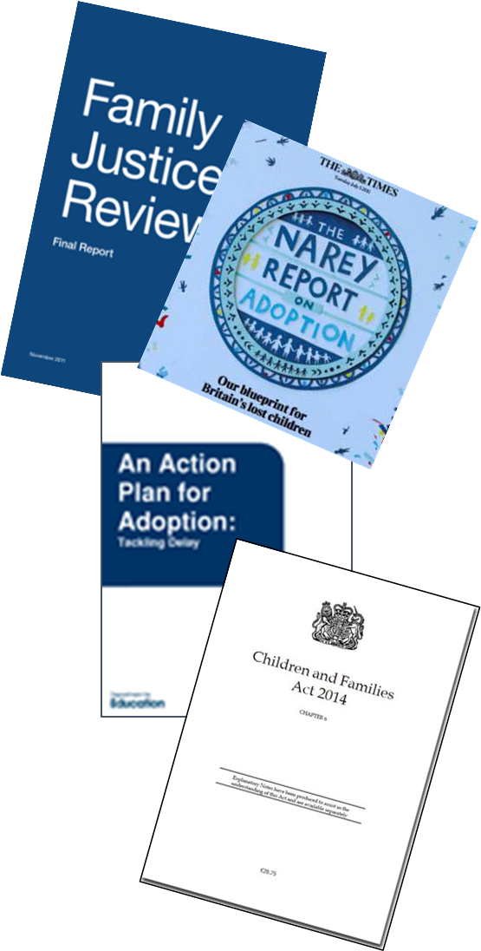
Introduction
Concurrent planning introduced into the UK in 1990s from USA. Projects set up in England eg Goodman in Manchester, Coram in London & Brighton & Hove – all except Coram failed
Government Concerns – significant delays in proceedings; children being placed for adoption older and after multiple moves
Suggested solutions – (inter alia) a statutory 26 week limit on care proceedings and support for fostering for adoption.

Slide 3
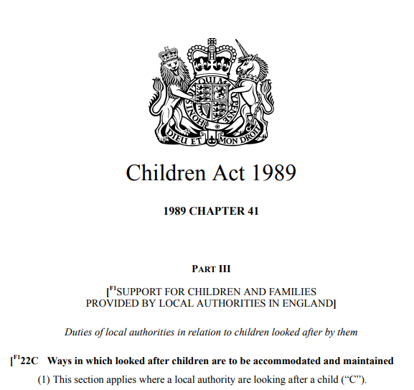
(9A) Subsection (9B) applies (subject to subsection (9C)) where the local authority ... —
(a) are considering adoption for C, or
(b) are satisfied that C ought to be placed for adoption but are not authorised under section 19 of the Adoption and Children Act 2002 (placement with parental consent) or by virtue of section 21 of that Act (placement orders) to place C for adoption.
(9B) Where this subsection applies—
(a) subsections (7) to (9) do not apply to the local authority,
(b) the local authority must consider placing C with an individual within subsection (6)(a), and
(c) where the local authority decide that a placement with such an individual is not the most appropriate placement for C, the local authority must consider placing C with a local authority foster parent who has been approved as a prospective adopter
Placement
Notes:
7 – 9 – placement in area – home/ education/ siblings/ disability – also removes preference in 7(a) for connected person
Considering not defined

Slide 4
Statutory guidance
2.6. There may be cases where a local authority identifies that, based on the evidence available and on its assessment of the case, the long term permanence plan for a child is likely to be adoption.
The local authority may still be considering other outcomes for the child, and may still be attempting rehabilitation with family, but expects that adoption will become the plan should those alternatives not succeed.
Local authorities must assess the appropriateness of placing the child in a FfA placement with dually approved carers on a case by case basis
Notes:
2.12 requires discussion with adopters

Slide 5
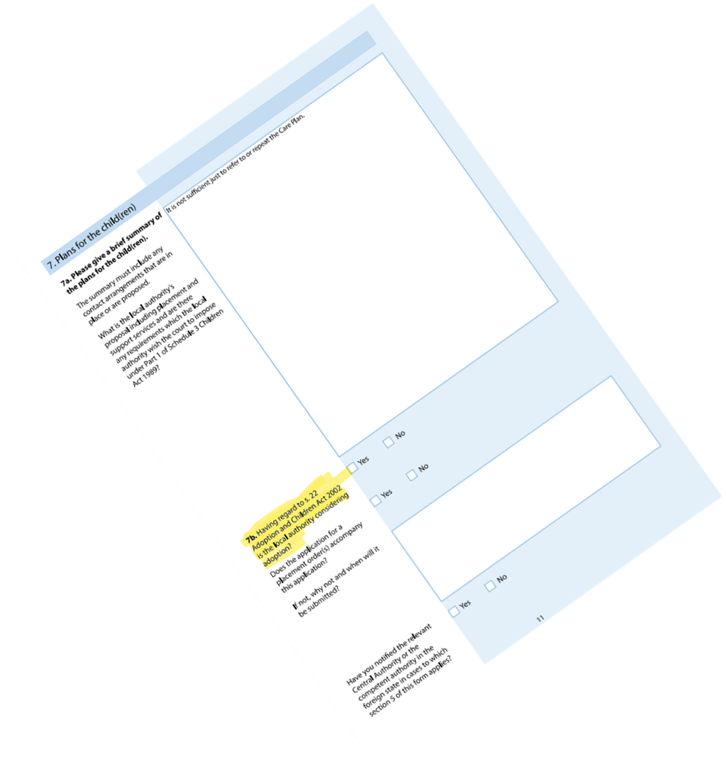
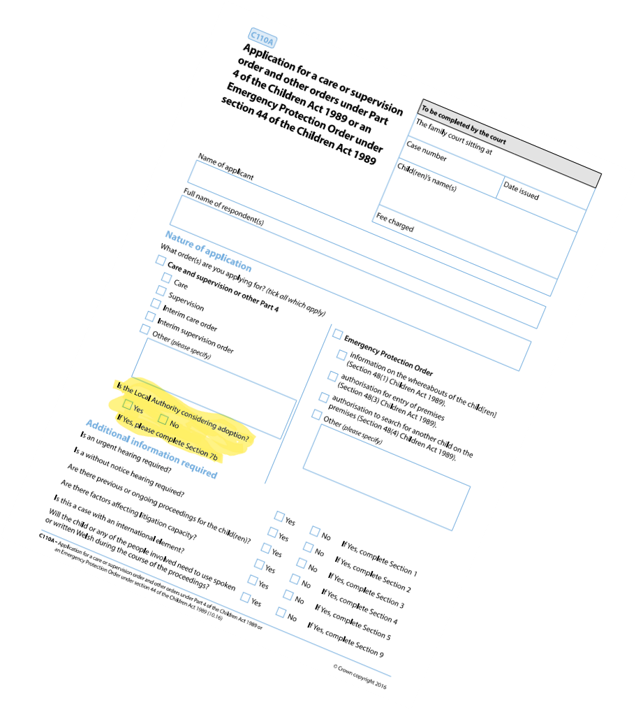
Requires the Local Authority to indicate whether or not they are considering adoption and therefore triggering their statutory duty to consider an Early Permanence Placement
C110A

Slide 6
Care Planning, Placement and Case Review (England) Regulations 2010
25A.—(1) Where the responsible authority is satisfied that—
(a) the most appropriate placement for C is with a person who is not approved as a local authority foster parent, but who is an approved prospective adopter, and
(b) it is in C’s best interests to be placed with that person,
the responsible authority may approve that person as a local authority foster parent in relation to C for a temporary period (“temporary approval period”) provided that the responsible authority first comply with the requirements of paragraph (2).

Slide 7
Status of early permanence carers
Carers are foster carers until they are matched to the child as prospective adopters and notified of the date on which the child will become placed for adoption
Can be dually approved, or temporarily approved under Reg 25A Care Planning Regulations 2010
No particular status because they are also EPP carers
LA still has a duty to consider any family who come forward and place with family if appropriate (S22C duty to prioritise family placement continues)
Shared Parental Leave Regulations 2014 – additionally defines placed for adoption at point of s22C placement for the purposes of adoption leave and pay only

Slide 8
“There is nothing in the recent case-law on adoption […] which justifies, let alone requires, any change in approach. Nor, in particular, is there anything in the status or function of an early permanence placement foster carer which either justifies or requires any change in approach.”
“Moreover, there is, [….], a very real risk that if, in a case such as this, the forensic process is allowed to become in effect a dispute between the prospective adopters and the birth family, the court will be diverted into an illegitimate inquiry as to which placement will be better for the child. That, it cannot be emphasised too much, is not the question before the court.”
“I merely note what I would hope is obvious: that in every case of an early permanence placement there must, from the outset and at every stage thereafter, be complete frankness coupled with a robust appraisal of the realities.”
Re T (A Child : Early Permanence Placement) [2015] EWCA Civ 983

Slide 9
Re T (A Child : early permanence or kinship carers) [2017] EWFC B43
LA placed child in EPP as had some concerns about potential kinship carer
Full positive kinship care assessment completed. ISW report felt T best option was adoption given his attachment to the EPP carers, but agreed relative could meet his needs
Court refused placement order
“The foster to adopt placement does not give any precedence or any rights to his current carers or require me to carry out an assessment of their individual qualities as carers”

Slide 10
Starred care plans – invented by the Court of Appeal to ensure compliance with care plans House of Lords rejected the concept
“The [Children] Act delineated the boundary of responsibility with complete clarity. Where a care order is made the responsibility for the child's care is with the authority rather than the court. The court retains no supervisory role, monitoring the authority's discharge of its responsibilities. That was the intention of Parliament.“
“Parliament entrusted to local authorities, not the courts, the responsibility for looking after children who are the subject of care orders”
Re S (FC) In Re S and Others In Re W and Others (Conjoined Appeals) [2002] UKHL 10

Slide 11
Re A (A Child) [2009] EWHC 865 (Fam)
“It is a cardinal principle of the Children Act 1989 (the 1989 Act) that once a care order has been made, whether interim or final, it is for the local authority, and not the court, to decide how to meet its parental responsibilities for the child. The decision-making power as to the care, residence and general welfare of the child is vested in the local authority, not in the court.” – Munby J

Slide 12
R (Care Proceedings Joinder of Foster Carers) [2021] EWCA Civ 875
Child removed at birth – place with f/c – F mis-identified, incurring delays
Paternal relatives came forward – full fostering assessment positive, but f/c decided they wanted to adopt. Court and CG supported f/c
Court joined f/c to care proceedings
C of A said not appropriate to join f/c, care proceedings have to be decided first, then placement, but as child had been with f/c for over a year, they were entitled to make adoption application and should be taken into account – application should be heard at the same time as the placement application

Slide 13
Re A, B And C (Adoption: Notification of Fathers & Relatives) [2020] EWCA Civ 41
3 separate appeals all heard together, issue whether family should be told about child to give chance of family placement v adoption
“Respect is due” to a relinquishing mother, but “majority of cases where the profound significance of the decision for the child demands that any realistic alternatives to adoption are given proper considerationconsideration”
No distinction in approach between care proceedings/relinquished baby/Part 19
Decision should be made pre-proceedings and Part 19 or inherent jurisdiction application made (High Court)

Slide 14
CoramBAAF members can contact the CoramBAAF Advice Line on 0300 222 5775 (Mon–Fri, 9am–1pm) or advice@corambaaf.org
Further resources: Search the bookshop | CoramBAAF

