Slide 1
Adoption: the role of early permanence and birth family contact in building children’s resilience Professor Beth Neil University of East Anglia MODERNISING ADOPTION & EARLY PERMANENCE CONFERENCE Durham, 21 October 2024

Slide 3
What is resilience? (Rutter, 2015)
Overcoming stress or adversity
Not a magical trait - is acquired, multidimensional and can change over time
Interaction of risks and protective factors at multiple levels: child, family, school, society
Can be built prior to encountering stress: e.g. though positive chances to manage stress - developing autonomy/coping skills, self belief/self liking; positive attachment experiences
Can operate after exposure to stress: e.g. changing difficult situations, receiving therapeutic help, new relationships and opportunities
Rutter, M. (2015). Resilience: concepts, findings, and clinical implications. In A Thapar et al (Eds).Rutter's child and adolescent psychiatry, 341-351.

Slide 4
Risks and resilience
The number of risks is important
Risk rarely occur in isolation
Some risks are socially constructed

Slide 5
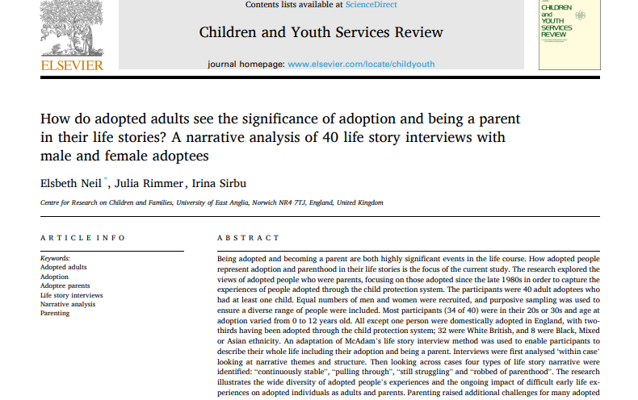
https://ueaeprints.uea.ac.uk/id/eprint/93549/1/1_s2.0_S0190740923004632_main.pdf

Slide 6
Naomi – cumulative risks (Neil, Rimmer & Sirbu, 2023)
Born with a disability and placed in foster care: zero to four, it’s like the age in which you learn how to build relationships and stuff like that. And it’s the most vulnerable time in your time and I spent that time being pushed around from different foster home to foster home
Bullying in school: when they find out that your parents aren’t your parents, [the other kids] were really horrible as well.
Clashes with adoptive parents: I was a very angry child, I really was and sort of no one understood sort of why
Loss and identity challenges: Understanding who you are, that’s been one of the main problems throughout my whole life… You grow up thinking that you were never wanted, like why is anyone gonna want me because my own mother didn’t want me…it has a really bad impact on how you form relationships
Adult life: I was so desperate to be wanted by everyone that I’d just throw myself at anyone and all my relationships have been violent… I’m trying to heal myself and be the best mum that I can be now

Slide 7
How did adoptive parents help build resilience? Neil et al, 2023)
Stability, love, understanding
Fighting to get help for children
Promoting birth family connections
Sticking by them “no matter what”
Accepting adoptee for who they are

Slide 8
The ‘Adoptive Families: what we need’ survey (Neil, Young & Hartley, 2018)
Online questionnaire for adoptive parents of children aged 0-17: open and closed questions (N=319)
Data about children’s backgrounds, adopters’ experiences, contact and moves from foster care
Overall ratings of adoption, and child’s progress in different areas – developmental measures
Notes:
NOT UPDATED - TO REMOVE?

Slide 9
Answers to ‘How is the adoption of your child faring overall?’
Mean/median age of child at time of survey = 7 years, range 0-17
Notes:
UPDATED

Slide 10
What factors predicted worse outcomes for children? (Neil et al, 2020)
Poorer outcomes related to:
Maltreatment index
More than 12 months in foster care (not with adopters)
More than 1 foster home
Children distressed on moving from foster care
Exposure to drugs/alcohol in utero
Parent/s with learning disability

Slide 11
The importance of relationships
Relational (psychological) permanence (Palacios et al, 2019)
(1) close, primary attachments of a child or young person to their caregiver(s) and other family members;
(2) reciprocal caregiver bonding to the child - unqualified lifelong commitment;
(3) each person having a sense of belonging permanently to each other (i.e., seeing themselves as a family)

Slide 12
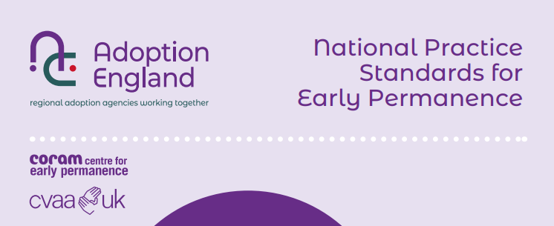
Early permanence
Child is cared for by carers who are dually approved as foster carers and adopters (CP or FfA) or, where the adopters have temporary approval as a foster carer and are also approved as adopters for a named child (FfA).
Fostering for adoption
Concurrent planning
Notes:
CP – there is plan A to go home and plan B adoption
FfA – no active plan for reunification – brought in in CFA 2014

Slide 13
Early permanence outcomes (Coram 2013)
Greater continuity of care before adoption
Earlier age at adoption
No disruptions
One third doing very well; one third had minor support needs, one third had higher support needs
… early placement has not prevented a significant minority of the children from experiencing considerable challenges.
Later placement and greater instability in infancy could only have increased these difficulties.
The fact that all placements have been sustained is very significant, and parents’ accounts of their commitment to their children were impressive.
(Coram 2013, p. 11)
Notes:
For babies, minimising delay and reducing placement moves needs to be key focus (Ward et al, 2012)

Slide 14
‘For all of us, just being there from... as early as you could have been… that offers stability, and you bond and you’ve got history together, and that’s what families have, isn’t it? Sam likes nothing better than saying ‘look at my baby photos’ and ‘what did I do as a baby?’ and I feel so blessed that we had them as babies and they’ve been part of our lives.’
(Adoptive parent in Coram, 2013, p. 14)

Slide 15
The complexity of early permanence
Adopters: an emotional journeys marked by uncertainty – but most feel like the child’s parent prior to placement order/adoption (Brown & Mason, 2021)
How family time is different in EP:
EP does not feel like foster care or adoption.
Parents and carers may experience ‘disenfranchised parenting’ (Copson, 2024), where both feel like the child’s parents but neither are able to fully claim to be a parent.
The challenges in parental identity can cause friction at family time - relationships between parents and carers in EP need considerable support
Good early relationships established lead to great opportunities to maintain relationships in the longer term

Slide 16
Barriers and solutions in achieving early permanency (Copson & Neil, in progress)
Regional variations
Not all children considered
Contact – missed opportunities
Professionals lack knowledge and confidence
Prospective adopters are uncertain – not enough carers
Additional strains for carers
Birth parents do not understand EP
Development of resources, training and guidance for professionals across different groups
Champions in agencies
Changes or additions to adopter preparation
Therapeutic support for carers
Enhanced support for birth parents
Organised systems for identifying matches

Slide 17
Complex loss and identity issues (Neil et al, 2023)
I felt when I was younger quite empty sometimes. I used to fill that void, ... I was going to school and stealing all the toys. […] I really do think it was because I didn't have my birth mum in my life. It haunted me….the jigsaw wasn’t complete in my life. (F09).
I had the worst upbringing…[My aunt] just told herself, that my birth mum was innocent. She would talk about it, and how it was a huge injustice, with me right there. (M02)

Slide 18
The importance of adoptive parents supporting birth family connections
My parents were always very open about what happened. That I could go and see my birth parents whenever I wanted. I had a file and I would go through the file and they would always make time to go through it. So, it was always just a very open experience, one that I found really interesting and I was comfortable with (F10).
I think my mother would rather not even think about it…she would just purely say “you're my daughter” and that was it – she didn’t want to go there. Or there might be a kind of spiteful comment… (M08)

Slide 19
How can safe and meaningful birth family contact build resilience?
Contact planning must protect child from risks related to having contact AND not having contact
Draw on sources of strength in the child’s network
Level of stress must be manageable – adopters key in providing ‘secure base’ for child
Building perspective taking, self-esteem and understanding life story
Skills and knowledge relevant to managing birth family relationships in adulthood

Slide 20
The current situation
Contact planning is formulaic
Direct contact is often cut off: unnecessary loss
Direct contact can feel unsafe or not ‘family like’
Letter contact is the norm, but most arrangements do not work well or at all
Adopted children have far less contact than those in other permanency placements
Teenagers/birth relatives make unsupported contact with each other which can be destabilising

Slide 21
Four areas for action – ideas for change (Neil, 2024)
Initiating and leading culture change
1
Preparing and matching adopters
2
Making child focussed contact plans
3
Supporting relationships
4

Slide 22
1: Initiating and leading change
Having dedicated ‘champions’ in agencies (supported by training and a ‘community of practice’)
Considering values and language and building in house capacity
Building relationships/collaboration with other professionals
Involving people with lived experience
Setting concrete, measurable goals

Slide 23
2: Preparing and matching adoptive parents
Messaging and language at all stages
Enable people to air feelings and anxieties
Input from people with lived experience
Podcasts, books, websites, research briefings etc
Discuss how openness can create a secure base with child
Clear expectations
Notes:
Orange group: Process for initiating and leading change
Blue: influencing adoptive parents and matching
Ped: child focussed, individual contact plans
Purple: supporting relationships (between birth/adoptive family/ adopters/siblings/child & adopters)
Support & review of plans.

Slide 24
3: Child focussed contact plans
Adoption worker getting involved at early stage
Ensuring all options are explored and rationale for plans is clear
Using contact planning tools
Questioning ‘risk’
Consider all available options, including digital
Positive search for the right adopters at matching stage

Slide 25
4: Supporting high quality relationships & openness
Initial meetings
Independent birth parent support services
Facilitate vs supervise family meetings
Named person or service for contact support
Offer review at key stages
Supporting adopters’ conversations with child/teenager

Slide 26
Conclusion - Relationships are the ‘golden thread’
Early permanence helps build secure relationships that will support the adopted person throughout their life
Adoption also carries risks related to loss of identity and supportive relationships, undermining resilience
Maintaining birth family relationships is positive where safe and meaningful
Quality of contact rests on relationships between all involved
EP offers unique opportunities to get ‘staying in touch’ plans off to a good start – but support is needed

Slide 27
Thank you for listening
Questions
Comments
e.neil@uea.ac.uk

